Slide 1

Distributed R for big data
Shivaram Venkataraman*, Indrajit Roy⁺, Alvin AuYoung⁺,
Rob Schreiber⁺, Erik Bodzsar#, Kyungyong Lee^{^+}
*UC Berkeley, ⁺HP Labs, #U Chicago, ^ UFL

Slide 2
Single Threaded
+
Single Machine
R

Slide 3
R
R
R
R
R

Slide 4
darray

Slide 5
foreach
f (x)

Slide 6
Power method with 1B edges,
Netflix ALS
Scale
20x faster than In-memory Hadoop
Speed

Slide 7
demo

Slide 8
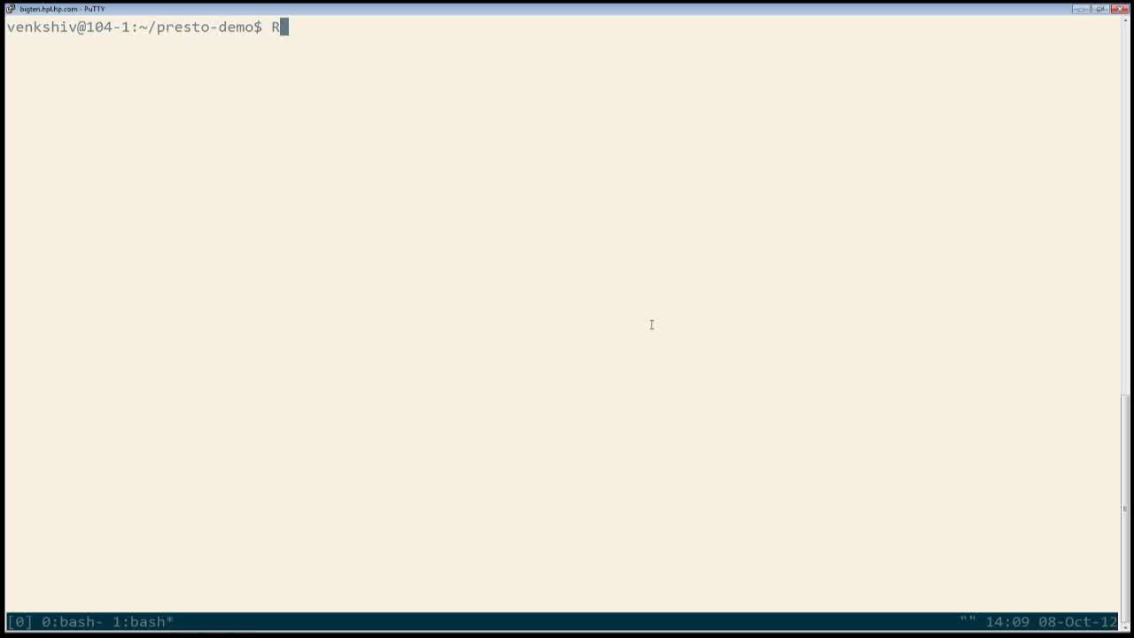

Slide 9
lj_matrix ← darray(dim=c(n,n),blocks=c(n,n))
in_vector ← darray(dim=c(n,1), blocks=(s,1), data=1/n)
out_vector ← darray(dim=c(n,1), blocks=(s,1))
foreach(i, 1:length(splits(lj_matrix)),
function(g = splits(lj_matrix, i),
i = splits(in_vector),
o = splits(out_vector, i)) {
n ← g %*% o
update(n)
})

Slide 10
Contact us - alpha version
tinyurl.com/presto-project
hpl.hp.com/research/presto.htm
presto-dev@external.groups.hp.com

Slide 12
R
R
R
R

